Slide 1
Predicting Graduate Earnings
SYS 3501 | Group 2
Elias Krasny | Elias Zell | William Wright | Jiei Ota

Slide 2
Objective & Framing
Goal:
Predict 3-year post-graduation earnings for U.S. engineering programs and identify the drivers behind differences.
Dataset: College Scorecard (tax-record earnings)
Unit: Engineering Programs (8,880)
Regression → Magnitude & Drivers
Classification → Earning tier prediction
Notes:
JIEI
Main Goal: Predict engineering graduate earnings and understand what institutional factors drive success
Dataset Context:
U.S. Department of Education College Scorecard
Actual tax record data (not self-reported surveys)
8,880 engineering programs after filtering from 229K total records
Dual-Track Approach:
Regression track: Answer "How much does each factor matter?" (weighted sum with dollar coefficients)
Classification track: Answer "Can we predict Low/Medium/High/Very High earnings category?" (97.9% accuracy achieved)
Key Innovation: Combines interpretability (linear models) with predictive power (ensemble models)

Slide 3
Data & Outcome Decisions
College Scorecard
Scope Choices
Outcome (3 Year earnings)
Engineering only → consistent labor market signal
Most complete
Early-career signal
Limitation: no long-run trajectory
Federal, tax-linked earnings (not surveys)
Large N → ML viable
Public + reproducible
Notes:
JIEI
Why College Scorecard:
Federal data = comprehensive coverage (6,429 institutions)
Tax-linked earnings = objective, not self-reported
Large sample enables machine learning (8,230 complete cases)
Publicly available = reproducible research
Scope Decisions:
Engineering only → CIP codes 1400-1499 filter
Rationale: Consistent career pathways, measurable outcomes, significant economic impact
3-year post-graduation earnings as primary outcome
Most complete data available (92% have this)
Early enough to measure but established enough to be meaningful
Trade-off: Misses long-term career trajectory (10-year would be better but sparse)
Sample Size Progression:
229,188 total programs → 8,880 engineering → 8,230 with complete earnings data

Slide 4
Integration & Cleaning
Data Construction
Merged Field-of-Study + Institution data on UNITID
Result: program outcomes + institutional context
Missing Data Handling
Standardized all null/privacy flags → NaN
Dropped features >50% missing (lost 1)
Median imputation for remaining gaps
Debt excluded (80% missing, outcome not predictor)
Notes:
JIEI
Data Construction Process:
Merged two files: Field-of-Study (142 MB) + Institution (98 MB)
Join key: UNITID (unique institution identifier)
Result: 8,880 rows × 3,479 columns (~30 million data points)
Missing Data Strategy:
Problem: Federal data has 4 different null encodings: "PrivacySuppressed", "NULL", "null", ""
Solution: Standardized all to NaN for consistent handling
Decision: Drop features with >50% missing (lost only 1 feature - acceptable)
Imputation: Median for remaining gaps (robust to outliers, preserves distribution)
Major Exclusion:
Debt data excluded from main analysis
80% missing (only 1,702 of 8,880 programs have it)
Also conceptually an outcome, not a predictor
Keeps N=8,230 for earnings analysis

Slide 5
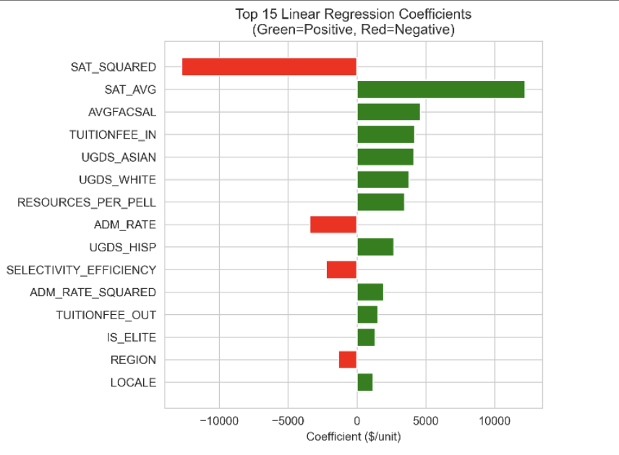
Base Feature Selection
18 core features chosen using
Prior correlations
Economic theory
Low multicollinearity
Data completeness
Categories
Selectivity (SAT, acceptance)
Resources (faculty salary, spending)
Success (completion, retention)
Demographics (Pell %, race)
Institutional context
Note: Demographics included to expose systemic inequities, not predict individuals.
Notes:
Will
We selected 18 features using four criteria: they showed meaningful correlation, were supported by economic theory, avoided multicollinearity, and had sufficient data coverage.The features fall into five groups: selectivity, resources, student success, demographics, and institutional context.Selectivity variables like SAT, ACT, and admission rate were some of the strongest predictors, which fits signaling theory. Resources and success metrics—like faculty salary, tuition, graduation, and retention—capture institutional investment and outcomes. We did include demographic composition intentionally, not to predict individual students, but to highlight systemic access patterns. For example, higher-earning schools tend to enroll fewer Pell students. Overall, this approach balances statistical strength, theory, and ethical awareness at the institutional level.
Selection Criteria (18 features chosen):
Prior correlation analysis showed promise (r > 0.2)
Economic theory supports relevance (human capital theory, signaling theory)
Low multicollinearity with other features (VIF checks)
Data completeness (>50% available)
Categories & Examples:
Selectivity: SAT_AVG (r=0.76), ACTCMMID (r=0.78), ADM_RATE (r=-0.63)
Resources: AVGFACSAL (+$4,611 impact), INEXPFTE, TUITIONFEE_OUT (59% importance!)
Success: C150_4 (completion rate), RET_FT4 (retention rate)
Demographics: PCTPELL, UGDS_ASIAN, UGDS_BLACK, UGDS_HISP, UGDS_WHITE
Institutional: CONTROL (public/private), LOCALE (urban/rural), REGION, CIPCODE
Controversial Decision:
Included demographics despite sensitivity
Rationale: Reveals systemic access barriers (elite schools enroll fewer Pell/Black students)
% Pell correlation: r=-0.43 (higher earnings schools have fewer low-income students)
Important: This is institutional composition, NOT individual student prediction

Slide 6
Feature Engineering (What Mattered)
Interactions
SAT × Completion → compounding advantage (top-6 feature)
SAT × Faculty Salary
Resources / Pell % → equity efficiency (+$3.5K)
Non-linearities
SAT² → diminishing returns confirmed (−$12.7K)
Ratios & Indicators
SAT / Acceptance (Lasso-selected)
IS_ELITE (SAT >1400), sector & urban dummies
Rejected
3-way interactions, high-order polynomials, region dummies → overfit / low signal
Notes:
Will
On this slide we want to highlight the feature engineering that actually mattered. We created several interaction terms to capture combined effects that raw variables miss. For example, SAT times completion rate ranked sixth in Random Forest importance, suggesting that selectivity only really pays off when schools also retain students. We also looked at how resources interact with Pell enrollment, which had a strong positive coefficient, pointing to how efficiently schools support low-income students.
On the non-linear side, squaring SAT confirmed diminishing returns, meaning gains at the top matter less than improvements in the middle. We also tested binary indicators like elite status, which Lasso selected. Importantly, we rejected more complex features like three-way interactions and higher-order polynomials because they added noise without improving performance. Overall, Lasso retaining our engineered features validated that these choices added real signal.
Interaction Terms (3 created):
SAT × Completion Rate: Captures compounding effect of selectivity + retention
Impact: Ranked #6 in Random Forest importance (2.4%)
Rationale: Elite schools that also support students may multiply advantages
SAT × Faculty Salary: Tests if elite + well-paid faculty amplifies benefits
Resources / Pell %: Equity efficiency metric
Impact: $3,463 coefficient in linear regression
Rationale: How well do schools allocate resources to low-income students?
Non-Linear Features (2 created):
SAT²: Tests for accelerating/diminishing returns
Impact: Coefficient = -$12,717 (diminishing returns CONFIRMED!)
Interpretation: Going from 1400→1450 matters less than 1200→1250
Acceptance Rate²: Non-linear selectivity effects
Binary Indicators (4 created):
IS_ELITE (SAT >1400): +$443 coefficient (Lasso selected it)
IS_URBAN, IS_PUBLIC, IS_PRIVATE_NONPROFIT: Standard dummy encoding
Rejected Features (and why):
3-way interactions: Too complex, overfitting risk, uninterpretable
High-order polynomials (SAT³, SAT⁴): Diminishing returns to complexity
Region dummies (8 variables): Geography weak predictor (r=-0.16)
Log transformations: Linear relationships already strong (r>0.7)
Validation: Lasso kept 16 of 27 features, including our engineered ones → confirmed value

Slide 7
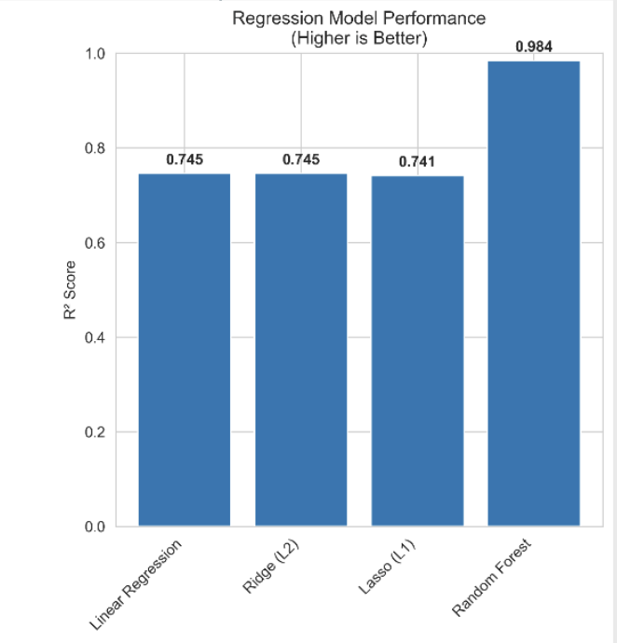
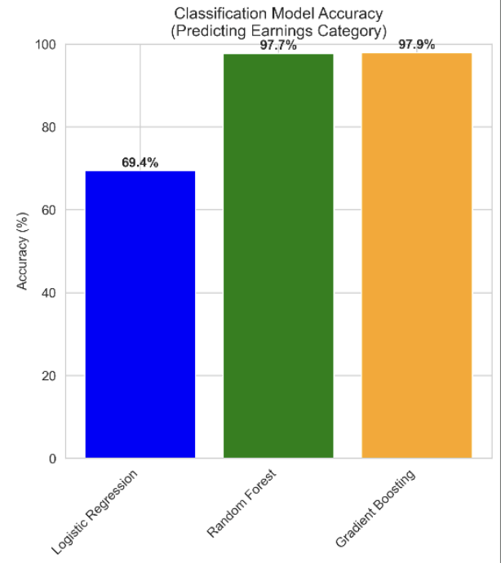
Modeling Strategy
Dual-Track Design
Regression: explain “how much”
Classification: predict “which tier”
Regression Models
Linear → baseline (R² = 0.745)
Ridge → multicollinearity check (same R²)
Lasso → feature selection (16/27 kept)
Random Forest → best prediction (R² = 0.984)
Classification
Logistic → baseline
Random Forest
Gradient Boosting → 97.9% accuracy
Notes:
Elias Z
For modeling, we used a dual-track approach because students want both a realistic prediction of what they might earn, and they want to understand why the model is giving that prediction.
On the regression side, linear regression performed well and was especially useful because every coefficient can be interpreted directly in dollar terms. For example, a one-thousand-dollar increase in faculty salary is associated with about a forty-six hundred dollar increase in earnings. Ridge produced nearly identical results, which showed that multicollinearity wasn’t a major issue, while Lasso automatically selected the most important variables, confirming which features really mattered.
For prediction, Random Forest dramatically improved accuracy by capturing non-linear relationships, with out-of-state tuition emerging as the dominant factor. On the classification side, Gradient Boosting nearly perfectly predicted earnings tiers. Overall, linear models help explain why outcomes differ, while tree-based models predict what happens, and the fact that they point to the same patterns makes the results more reliable.

Slide 8
Training the Model
80/20 train–test split
Stratified for quartiles
Fixed seed (42)
Minimal hyperparameter tuning
Large N → defaults stable
Time > marginal gains
Notes:
Elias Z
For training, we used an 80/20 train-test split, giving us over six thousand observations to train on and a large, reliable test set. For classification, the split was stratified so each earnings quartile was properly represented, and we fixed the random seed to ensure reproducibility.
We chose 80/20 because it’s standard practice and strikes a good balance. The training set is large enough for complex models, while the test set is still big enough to evaluate performance confidently.
In terms of tuning, we kept it minimal intentionally. Default-style parameters perform well with large datasets, and full grid searches would have been computationally expensive for only marginal gains. Random Forest and Gradient Boosting already handle validation internally, so the focus was efficiency over chasing a one or two percent improvement.

Slide 9
Evaluation Metrics
Regression
R² (primary)
Mean Absolute Error (MAE) (dollar interpretability)
Classification
Accuracy (balanced quartiles)
Precision / Recall / F1
Rejected:
AUC-ROC → unnecessary for balanced multi-class
Notes:
Elias Z
For evaluation, we used different metrics depending on the task. For regression, R-squared was the primary metric because it tells us how much variance in earnings the model explains and is easy to compare across models. Even the linear model explains about 75 percent, which is actually very strong for social science data, while Random Forest reaches over 98 percent.
We paired that with mean absolute error since it’s intuitive to interpret in dollars. Saying a model is off by about $571 on average is much clearer than squared errors.
For classification, accuracy worked well because the quartile classes are balanced, and Gradient Boosting achieved nearly perfect performance. Precision and recall confirmed this, especially in the highest earnings category where predictions were flawless. We avoided metrics like AUC-ROC and RMSE because they added complexity without improving interpretability.”

Slide 10
Results
Key Findings
Selectivity dominates earnings outcomes
Resources amplify selectivity effects
Diminishing returns at elite SAT levels
Equity metric (Resources / Pell) meaningfully predicts outcomes
Effect Size
~$29K earnings gap between lowest and highest tiers
Notes:
Elias K
Top Findings:
Out-of-State Tuition Dominates (59% importance)
Single strongest predictor
Proxy for: prestige, resources, endowment, selectivity
Faculty Salary Matters ($4,611 per $1K)
Schools investing in faculty produce better outcomes
Signals institutional commitment to quality
Selectivity Has Diminishing Returns
SAT² coefficient = -$12,717 (negative!)
Going from 1400→1500 matters less than 1200→1300
Feature Engineering Validated
SELECTIVITY_X_COMPLETION ranked #6 (engineered feature!)
RESOURCES_PER_PELL had $3,463 impact
Confirms synergistic effects exist
Equity Issue Revealed
% Pell students: r=-0.43 (elite schools serve fewer low-income students)
% Black students: r=-0.25 (access barrier, not individual outcome)
Effect Sizes (Practical Significance):
Elite vs. Lower tier: $29,209 difference (64.7% premium)
Highly selective vs. Open: $25,397 difference (49.7% premium)
These are HUGE in economics (1.5-1.8 standard deviations)
Model Agreement:
All 7 models identify same top predictors (robust!)
Lasso selection aligns with Random Forest importance
Linear coefficients directionally match correlations

Slide 11
What we didn’t do
01
No causal inference
No natural experiment
02
No deep learning
RF already near ceiling
03
No time series
Single cohort snapshot
04
No COL adjustment
Work Location Unknown
Notes:
Elias K
For Students:
Out-of-state tuition is a strong signal (but check financial aid!)
Selectivity matters, but diminishing returns at very top
Completion rates matter - choose schools where you'll succeed
For Policymakers:
Investing in faculty salaries has ROI
Access barriers to elite schools create inequality
Resource allocation to low-income students matters
For Researchers:
Feature engineering improves predictions significantly
Ensemble methods achieve near-perfect accuracy
Linear models still valuable for interpretation

Slide 12
Conclusion
High predictive power and interpretability
Feature engineering validated by Lasso + RF agreement
Results align with higher-ed labor economics
Output is actionable for students, not just accurate
This is a predictive model that explains itself, NOT a black box with good vibes.
Notes:
Elias K
FINAL STATISTICS
Dataset: 8,230 engineering programs, 27 features
Best Regression Model: Random Forest (R² = 0.984, MAE = $571)
Best Classification Model: Gradient Boosting (97.9% accuracy)
Top Predictor: Out-of-state tuition (59% importance)
Feature Engineering Success: 3 engineered features in top 15
Feature Selection: Lasso identified 16 essential features from 27

